Slide 1
Structural Gravity Model Estimation Using India-CPTPP Trade Data
and Counterfactual Analysis

Slide 2
Table of contents
01
02
03
04
05
06
Introduction
Objective
Model Estimation
GEPPML Algorithm
Results
Conclusion

Slide 3
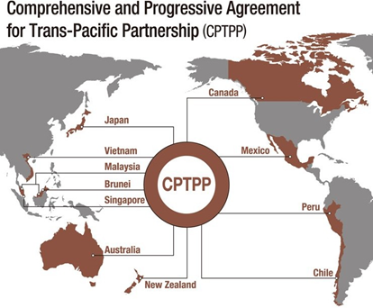
Introduction
The Comprehensive and Progressive Agreement for Trans-Pacific Partnership (CPTPP) is a significant free trade agreement (FTA) in the Asia-Pacific region.
In this presentation, we will delve into the agreement's origins, member states, and its economic impact. We will also explore the potential ramifications of India's accession and the UK's impending membership.
Finally, we will examine analytical frameworks used to assess trade dynamics within the CPTPP.

Slide 4
The Gravity Model
The gravity model forms the bedrock of empirical trade analysis, drawing an analogy between trade volume and gravitational attraction.
The model suggests a positive correlation between trade volume and the economic size (GDP) of trading partners.
Conversely, it suggests an inverse relationship with trade costs, often measured by geographical distance.
McCallum's (1995) application to US-Canada trade revealed the "Border Puzzle," highlighting the limitations of the basic model.
Anderson and Wincoop's (2003) structural gravity model addressed these shortcomings by incorporating MTR (multilateral trade resistance) and firm heterogeneity.
Notes:
The gravity model is a fundamental tool for analyzing trade flows. It posits a relationship between trade volume and the economic heft (GDP) of trading partners, similar to the concept of gravity. However, trade costs, typically measured by distance, play an opposing role. McCallum's (1995) work exposed limitations in the basic model, while Anderson and Wincoop's (2003) structural model offered a more nuanced perspective by incorporating additional factors like trade barriers between third-party nations and variations in firm-level productivity. We will delve deeper into estimation methodologies and trade impact assessments in the next section.

Slide 5
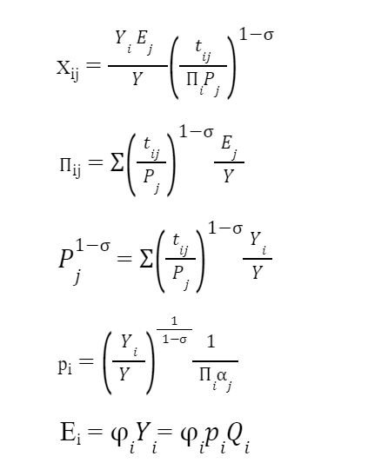
The Structural Gravity System
Xij: nominal trade volume from exporter i to importer j
Ej: total expenditure of importer j
Yi: The value of total production in exporter i
Y: the value of world output
tij: bilateral trade costs between partners i and j
σ: elasticity of substitution for goods of different countries (Hereσ>1)
αi : CES preference parameter
Pj: Inward multilateral resistances (IMR)
Πi: outward multilateral resistances (OMR)
pi: factory-gate price for each variety of goods in the country of origin i
Qi: the endowment or quantity supplied of each variety of goods in country i

Slide 6
Objective
This research analyzes the effects of the Comprehensive and Progressive Agreement for Trans-Pacific Partnership (CPTPP) on India's trade with member countries.
CPTPP aims to reduce trade barriers (tariffs & non-tariff) between members, potentially making trade cheaper and easier.
We utilize a structural gravity model to assess how these changes, economic size (GDP), and traditional trade costs (distance, tariffs) influence India's trade with CPTPP members.
Counterfactual analysis is conducted to estimate trade flows under two scenarios:
Scenario 1: No CPTPP (assumes no agreement exists)
Scenario 2: India Joins CPTPP (predicts trade flows if India becomes a member)
Notes:
This research investigates the impact of the CPTPP, a free trade agreement among Pacific Rim nations, on India's trade with member countries. The agreement aims to eliminate or reduce trade barriers, potentially streamlining trade processes. We employ a structural gravity model to analyze how these changes, along with economic factors (GDP) and traditional trade costs (distance, tariffs), affect India's trade with CPTPP members. To gain a more comprehensive understanding, we conduct counterfactual analysis, estimating trade flows under two scenarios: one where the CPTPP doesn't exist and another where India joins the agreement. This analysis will provide valuable insights into the potential benefits and considerations for India's trade ties with the CPTPP region.

Slide 7
Data
Trade data was collected for the year 2021 and 2018, encompassing trade flows between India and CPTPP member countries.
Data was sourced from a reliable trade database like the World Trade Organization (WTO) Trade Map or the United Nations Comtrade database.
We focused on five key products with significant economic importance and trade volume for in-depth analysis.
While the current CPTPP membership stands at 11, we included the UK for analytical purposes in 2021 dataset.
To assess the General Equilibrium impact of India's potential membership, data for the Top 10 GDP countries (based on World Bank 2022 data) was incorporated.
This comprehensive dataset encompassed 20 countries:
USA, UK, Brazil, Malaysia, China, France, Australia, Chile, Japan, Russia, Mexico, New Zealand, Germany,Canada, Singapore, Peru, India, Italy, Vietnam, Brunei

Slide 8
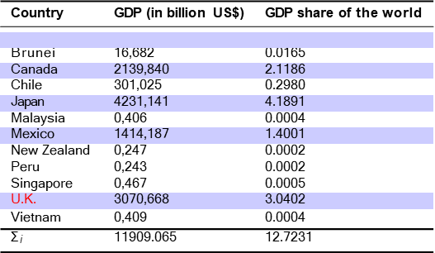
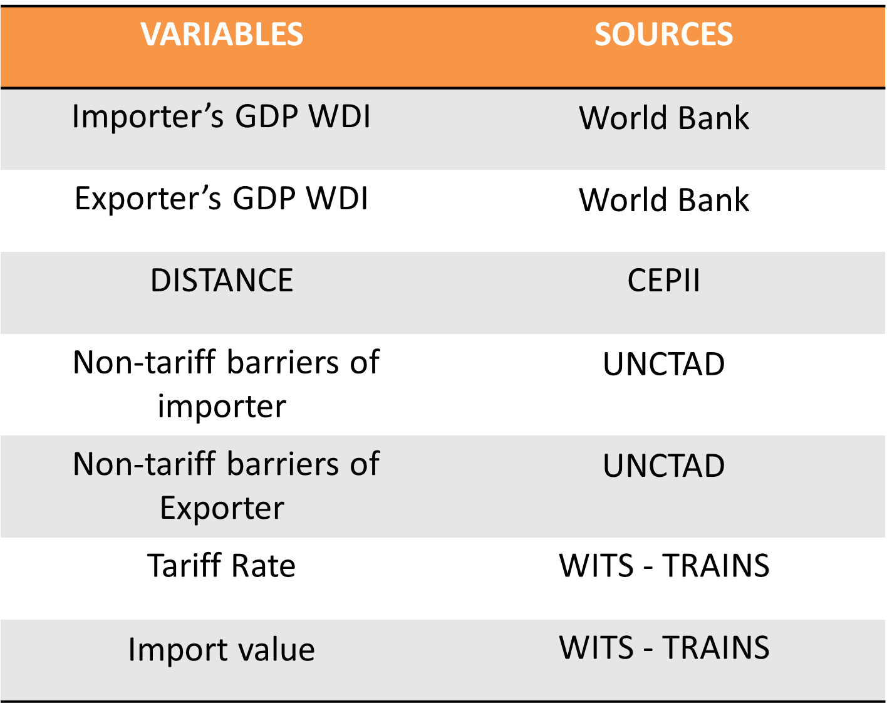
Data
World GDP in 2022: 101.003 Trillion US$
Total CPTPP Population = 518 million4 (≈ 6.5% of world Pop.)

Slide 9
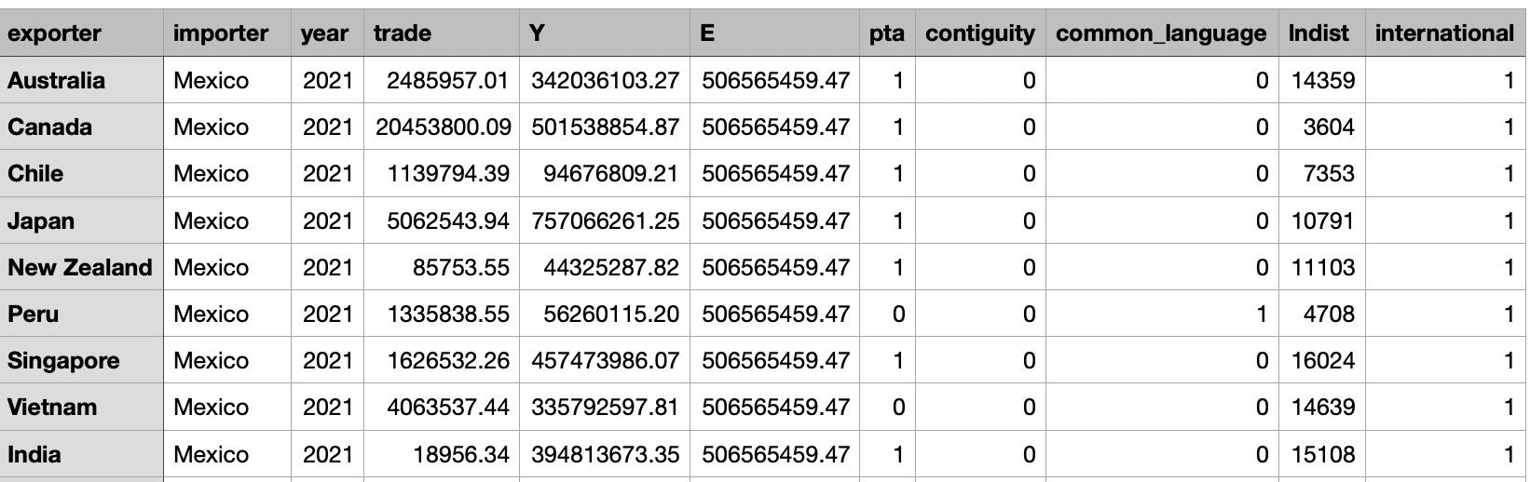
First Seven rows of our dataset

Slide 10
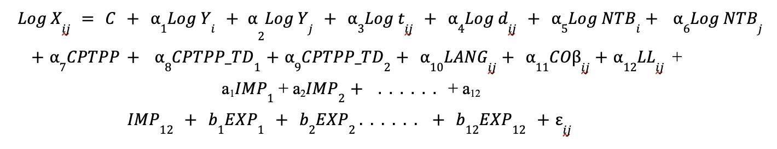
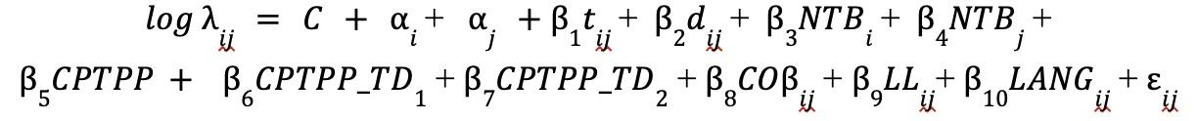
Model Estimation
Model estimation is done using these methodologies-
Two-way fixed effects methodology.
Controls for country-specific factors influencing trade flows, isolating the effects of independent variables (GDP, distance, tariffs, NTBs, and CPTPP membership).
Poisson Pseudo Maximum Likelihood Estimation methodology.
Addresses the count data nature of the dependent variable, providing more reliable estimates than traditional OLS methods.
(insert eqn)

Slide 11
Model Estimation
NLS-GEPPML
Employs the NLS-GEPPML algorithm (Herman's Method) as implemented in the 'gegravity' package (Herman, 2021). The general equilibrium PPML (GEPPML) iterative procedure, as stated in Yotov’s advanced guide, was used to get the GE impacts from counterfactual scenarios.

Slide 12
GEPPML Algorithm
STEP 1: Solving the baseline gravity model
Obtain the estimate of Pair Fixed effects (ij) and the effects of RTAs
Regress the estimates of Pair Fixed effects on the gravity variables and country fixed effects.
STEP 2: Defining a counterfactual scenario
STEP 3: Solving the Counterfactual Model
Obtaining the “Conditional General Equilibrium” Effects
Estimating the “Conditional” gravity model
Constructing the “Conditional general equilibrium” indexes
Obtaining the “Full Endowment General Equilibrium” effects
STEP 4: Collect, Construct, & Report Indexes Of Interest
STEP 5: Constructing the Confidence Interval

Slide 13
Solving Strategies
Packages (only) for robust and fast econometric estimation of gravity models
• STATA : ppml 10
• R : gravity 14
• Python :gme 15
• Tools for ”Full Fledged” Gravity Analysis (along with CFLs):
• STATA :
• the readymade .do file provided in [Yotov et al., 2016] employs GEPPML algo
• GE gravity package16
• Python : gegravity package by [Herman, 2021] : solves GE gravity models and conducts CFL experiments, using econometrically estimated parameter values from gme package. gegravity
Employs NLS algorithm

Slide 14
Trade Impact Measures
Partial Trade Impact (PTI):
Focuses on the direct impact of trade cost changes on trade volumes.
Assumes constant prices and wages (simplifying assumptions).
Offers a starting point but may underestimate the full picture.
Modular Trade Impact (MTI):
Considers trade cost changes and their influence on price indexes.
Holds GDP constant, acknowledging the link between trade costs and prices.
Provides a more comprehensive view by incorporating price adjustments.
General Equilibrium Trade Impact (GETI):
Most comprehensive assessment, considering trade costs, price indexes, and wages.
Captures the full economic impact, including potential GDP changes.
Offers a realistic view but is also the most complex to implement.

Slide 15
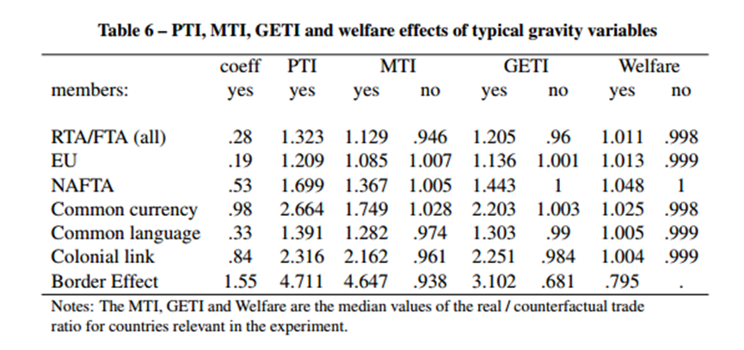

Slide 16
Two-Way Fixed Effects:
Results
Number of observations | 471
F( 24, 446) | 16.02
Prob > F | 0
R-squared | 0.3413
Root MSE | 1.4507
Most of our independent variables got significant estimates, and signs of estimates were also on expected lines with GDPs of trading countries having a positive relationship with trade value and trade cost variables like distance, tariff rates and Non-Tariff Barriers having a negative relationship with import value. The trade creation dummy is also positive and significant, showing that CPTPP is indeed trade-creating among member countries

Slide 17
PPML Methodology
Results
The PPML estimates were calculated on a count dataset where zero values of import values were also included in our analysis. The estimates were again on expected lines for independent variables, with most of them being significant and the trade creation dummy being positive, indicating the relevance of this alliance for the member nations.
No. of parameters - 26 No. of observations - 555 Pseudo Log-Likelihood - -1.661e+08
R-squared - 0.19771378

Slide 18
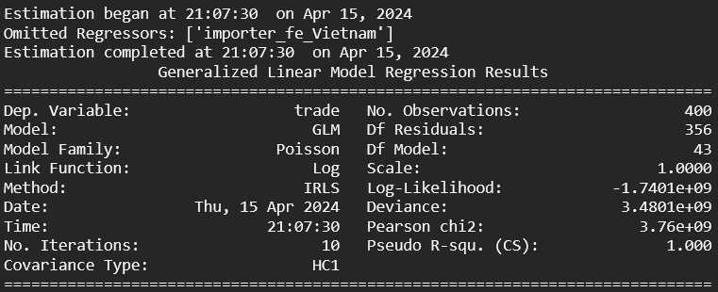
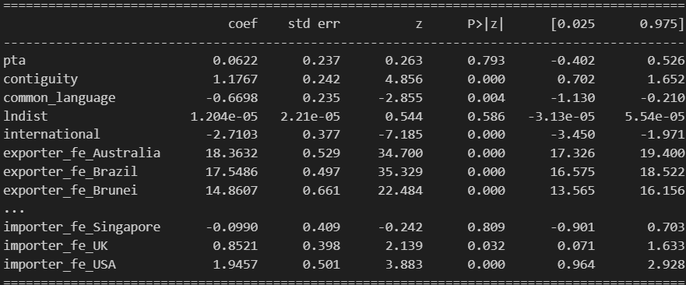
Preferential Trade Agreements (PTAs):
Our analysis yields a positive and statistically significant coefficient for PTAs (0.0622), corroborating their trade-enhancing effect.
This aligns with the theoretical underpinnings of PTAs, which posit a reduction in trade barriers, leading to increased trade between signatory nations.
Geographical Contiguity:
Contiguity emerges as a powerful explanatory variable, exhibiting a positive and statistically significant coefficient (1.1767).
This aligns with the "gravity models" concept, where geographical proximity translates to lower transportation costs and potentially shared infrastructure, fostering intensified trade relations between neighbouring countries.

Slide 19
Distance (lnDist): While theory suggests a negative association with trade volume due to transportation costs, our model yields a counterintuitive positive (though statistically insignificant) coefficient.
This warrants further investigation, considering:
Robust logistics networks in major economies potentially mitigating distance barriers.
The growing influence of e-commerce and efficient international shipping.
International Trading Relations & Common Language:
Both variables show negative coefficients (potentially indicating a trade-dampening effect), which contradicts traditional economic theory.
However, the lack of statistical significance is crucial.
This compels a reevaluation in the context of hyper-globalization:
Advancements in communication technologies might enable trade irrespective of formal agreements or shared language.
The insignificance suggests a need for more robust determinants of trade patterns in the analyzed sample.

Slide 20
Impact At Individual Country Level
Notes:
The gravity model is a fundamental tool for analyzing trade flows. It posits a relationship between trade volume and the economic heft (GDP) of trading partners, similar to the concept of gravity. However, trade costs, typically measured by distance, play an opposing role. McCallum's (1995) work exposed limitations in the basic model, while Anderson and Wincoop's (2003) structural model offered a more nuanced perspective by incorporating additional factors like trade barriers between third-party nations and variations in firm-level productivity. We will delve deeper into estimation methodologies and trade impact assessments in the next section.

Slide 21
 | Factory Gate Price Change (percent)
USA | 0.0776
China | 0.0726
Japan | 0.0746
Germany | 0.0752
India | 0.1516
UK | 0.0983
France | 0.0764
Russia | 0.0734
Canada | 0.1006
Italy | 0.0747
Brazil | 0.0737
Australia | 0.0713
Mexico | 0.0744
Singapore | 0.0763
Vietnam | 0.1216
Malaysia | 0.0761
Chile | 0.0731
New Zealand | 0.1166
Peru | 0.1431
Brunei | 0.0739
Factory Gate Prices
India's accession to the CPTPP will likely trigger a positive shift in factory gate prices across member countries. This phenomenon aligns with the concept of comparative advantage, suggesting increased demand for previously imported Indian goods. The observed price adjustments reflect a realignment of trade patterns within the CPTPP, highlighting the dynamic impact of India's integration on pricing mechanisms and trade flows.

Slide 22
 | GDP change (percent)
USA | -0.0019
China | -0.0077
Japan | -0.0049
Germany | -0.0035
India | 0.1516
UK | 0.0387
France | -0.0023
Russia | -0.004
Canada | 0.04
Italy | -0.0049
Brazil | -0.0077
Australia | 0.0181
Mexico | -0.0053
Singapore | -0.0027
Vietnam | 0.0385
Malaysia | -0.0041
Chile | -0.0081
New Zealand | 0.0659
Peru | 0.0602
Brunei | -0.0075
GDP
CPTPP Members:
Positive GDP changes anticipated due to:
Market expansion
Larger consumer base
Potential for higher export markups
Non-Members:
Risk negative GDP changes from:
Trade diversion towards India
Reduced trade flows
Incentive for non-members to pursue bilateral agreements with India

Slide 23
 | Welfare Statistics
USA | 1.00002
China | 1.00008
Japan | 1.00005
Germany | 1.00004
India | 0.99849
UK | 0.99961
France | 1.00002
Russia | 1.00004
Canada | 0.9996
Italy | 1.00005
Brazil | 1.00008
Australia | 0.99982
Mexico | 1.00005
Singapore | 1.00003
Vietnam | 0.99962
Malaysia | 1.00004
Chile | 1.00008
New Zealand | 0.99934
Peru | 0.9994
Brunei | 1.00007
Welfare Statistic
Marginal positive values suggest a slight increase in welfare after India's accession. This could be explained by trade diversion leading to resource allocation shifts within the CPTPP, potentially benefiting some countries. Additionally, the exit of a large producer like India may create market opportunities for smaller non-member countries, further contributing to the observed positive welfare changes

Slide 24
OMR & IMR
Outward Multilateral Resistance (OMR) Decreases: This suggests reduced trade frictions and potentially lower logistical costs across the entire CPTPP, fostering stronger trade ties.
Inward Multilateral Resistance (IMR) Increases: Countries may become more cautious about imports, potentially adjusting trade agreements to make them more selective. This could be due to strategic considerations around India's entry and a need to re-evaluate import reliance within the new trade landscape.

Slide 25
 | Baseline OMR | Experiment OMR | OMR Change Percent
USA | 1.5477 | 1.5465 | -0.0776
China | 1.6206 | 1.6194 | -0.0725
Japan | 1.7767 | 1.7753 | -0.0746
Germany | 1.6931 | 1.6918 | -0.0751
India | 1.7875 | 1.7848 | -0.1514
UK | 1.8401 | 1.8383 | -0.0983
France | 1.8496 | 1.8482 | -0.0763
Russia | 1.8692 | 1.8678 | -0.0733
Canada | 1.7973 | 1.7955 | -0.1005
Italy | 1.7699 | 1.7686 | -0.0746
Brazil | 1.8405 | 1.8391 | -0.0736
Australia | 1.9428 | 1.9414 | -0.0712
Mexico | 1.7747 | 1.7734 | -0.0743
Singapore | 1.8921 | 1.8906 | -0.0762
Vietnam | 1.765 | 1.7629 | -0.1215
Malaysia | 1.944 | 1.9426 | -0.076
Chile | 1.8669 | 1.8655 | -0.0731
New Zealand | 1.9911 | 1.9888 | -0.1165
Peru | 1.8786 | 1.876 | -0.1429
Brunei | 1.8084 | 1.8071 | -0.0738
 | Baseline IMR | Experiment IMR | IMR Change Percent
USA | 1.0044 | 1.0052 | 0.0795
China | 0.8946 | 0.8953 | 0.0803
Japan | 1.0132 | 1.014 | 0.0795
Germany | 0.9643 | 0.9651 | 0.0787
India | 1 | 1 | 0
UK | 1.0755 | 1.0761 | 0.0596
France | 0.9687 | 0.9694 | 0.0787
Russia | 0.9618 | 0.9625 | 0.0774
Canada | 1.0517 | 1.0524 | 0.0606
Italy | 1.0248 | 1.0256 | 0.0796
Brazil | 1.0544 | 1.0552 | 0.0814
Australia | 1.0703 | 1.0708 | 0.0531
Mexico | 0.9998 | 1.0006 | 0.0797
Singapore | 1.0438 | 1.0446 | 0.079
Vietnam | 0.9774 | 0.9782 | 0.0831
Malaysia | 1.0252 | 1.026 | 0.0802
Chile | 1.0646 | 1.0655 | 0.0813
New Zealand | 1.1208 | 1.1214 | 0.0507
Peru | 1.0561 | 1.057 | 0.0828
Brunei | 1.0913 | 1.0922 | 0.0813

Slide 26
Net Foreign Exports and Imports
Trade volumes for most country pairs are expected to increase with India's CPTPP membership.
This aligns with the addition of a major market like India, disrupting existing patterns and boosting overall trade activity.
Both Net Foreign Exports and Net Foreign Imports are likely to rise due to heightened trade flows between CPTPP countries and India.
 | Baseline Modelled Foreign Export | Experiment Foreign Export | Foreign Export Change
USA | 614914430.6 | 615314535.7 | 0.065
China | 1877863684 | 1878956906 | 0.058
Japan | 534693507.8 | 535063317.7 | 0.069
Germany | 1025298145 | 1026004916 | 0.069
India | 314402395.7 | 315417176.7 | 0.323
UK | 286911644.7 | 287497163.9 | 0.204
France | 430392216.6 | 430706406.5 | 0.073
Russia | 445554813 | 445885084.8 | 0.074
Canada | 390487649.1 | 391078120.1 | 0.151
Italy | 482527677.8 | 482870345.9 | 0.071
Brazil | 251238326.2 | 251421687.3 | 0.073
Australia | 284954374.7 | 285208087.8 | 0.089
Mexico | 409503646.5 | 409797622 | 0.072
Singapore | 357779314.9 | 358041887.2 | 0.073
Vietnam | 305699774.8 | 306129936.9 | 0.141
Malaysia | 262635449.3 | 262829159.1 | 0.074
Chile | 91756588.91 | 91824870.56 | 0.074
New Zealand | 43338738.08 | 43395122.1 | 0.13
Peru | 55956569.32 | 56042162.92 | 0.153
Brunei | 11287528.16 | 11295936.25 | 0.074

Slide 27
Bilateral Trade Results
Observed that the trade change is +ve only for UK, Canada, Australia & New Zealand ⇒ India’s ‘export’ to these 4 CPTPP countries increases when India joins the trading block.
For rest of the 16 countries trade change is -ve ⇒ India’s ‘export’ with these countries decreases. Perhaps the ‘export’ gets rerouted to UK, Canada, Australia & New Zealand
Observed that the trade change is +ve only for UK, Canada, New Zealand & Peru ⇒ India’s ‘import’ from these 4 CPTPP countries increases when India joins the trading block.
For rest of the 16 countries trade change is -ve ⇒ India’s ‘import’ with these countries decreases. It is highly likely that India will become more dependent on UK, Canada, New Zealand & Peru to meet its deﬁcient ‘import’ demand.

Slide 28
Results
D. Trade Impact Terms
﻿﻿Partial Trade Impact Term (PTI)
﻿﻿Modular Trade Impact Term (MTI)
﻿﻿General Equilibrium Trade Impact Term (GETI)
Members | Coefficient Yes | PTI Yes | MTI |  | GETI |  | Welfare
 |  |  | Yes | No | Yes | No | Yes | No
RTA / FTA | 0.05 | 1.053 | 1.021 | 0.989 | 1.036 | 0.99 | 1.002 | 1.000
EU | 0.18 | 1.201 | 1.101 | 0.991 | 1.179 | 1.000 | 1.003 | 1.000
CPTPP | 0.51 | 1.693 | 1.663 | 1.005 | 1.677 | 1.000 | 0.99835 | 1.000
Common Currency | 0.62 | 1.966 | 1.063 | 1.003 | 1.09 | 0.999 | 1.003 | 1.000
Common Language | 0.21 | 1.249 | 1.242 | 0.954 | 1.726 | 0.982 | 1.008 | 0.998
Colonial Link | 0.43 | 1.557 | 1.578 | 1.004 | 1.780 | 0.988 | 0.9976 | 0.999
Border Effect | 0.96 | 2.659 | 4.006 | 1.198 | 0.781 | 2.491 | 0.847 | -

Slide 29
Conclusion
India’s accession into CPTPP has overall positive Welfare Impacts on all the countries under consideration
The Inward Trade Resistance term (IMR) of all the countries increases and the Outward Trade Resistance term (OMR) of all the countries decreases ⇒ All the countries becomes more resistant towards import and favors export (ie the countries adopt policy so as to promote their export)
We see a decrease in shipment volumes due to the loss of a major trading partner. This would be reﬂected in lower imports from India and potentially lower exports to India
India’s market is substantial, and its accession into CPTPP would enhance the size of the CPTPP market, leading to signiﬁcant changes in trade volumes for member countries as well as Non-members countries.
Therefore India’s accession into CPTPP seems to be favourable, but more weight can be given to the statement only after inclusion of bigger GDP Countries like US, China.

